Slide 1
Business and Industrial Economics
A.Y. 2023/2024
Prof. Mattia Pedota
Concentration Indices

Slide 2
AGENDA
Concentration – The concept
Definition
Market shares
Concentration vector
Concentration curve
Concentration indices
Absolute
Concentration ratio
Herfindal index
Entropy index
Relative
Lorenz curve
Gini index
Qualitative classification

Slide 3


Why industry concentration matters?
One of the most studied areas in the domain of market structure, particularly in the industrial organization literature.
When antitrust agencies are evaluating a potential violation of competition laws, they will typically attempt to measure concentration within the relevant market.
%
ANTITRUST AGENCIES

Slide 4
Concentration - The concept (1)
Intuitively, concentration depends on the number and size of the firms belonging to the focal industry
Concentrated industry:
Very few firms
Or many firms, but few of very large size
Dispersed industry:
Many firms
None of the firms has a dominant position

Slide 5
Why studying it?
In a nutshell, concentration:
is useful to get a clear and immediate snapshot of the focal industry;
is a fundamental metric for antitrust agencies;
affects firms’ behavior and offers indications on competition mechanisms.
Analysis of the causal relationship:
Is concentration leading to market power or viceversa?

Slide 6


Concentration: link with market structure
Competitive industries are characterized by low concentration. The minimum level of concentration is reached in the case of perfect competition
Oligopolistic industries are characterized by high concentration. The maximum level of concentration is reached in the case of monopoly

Slide 7

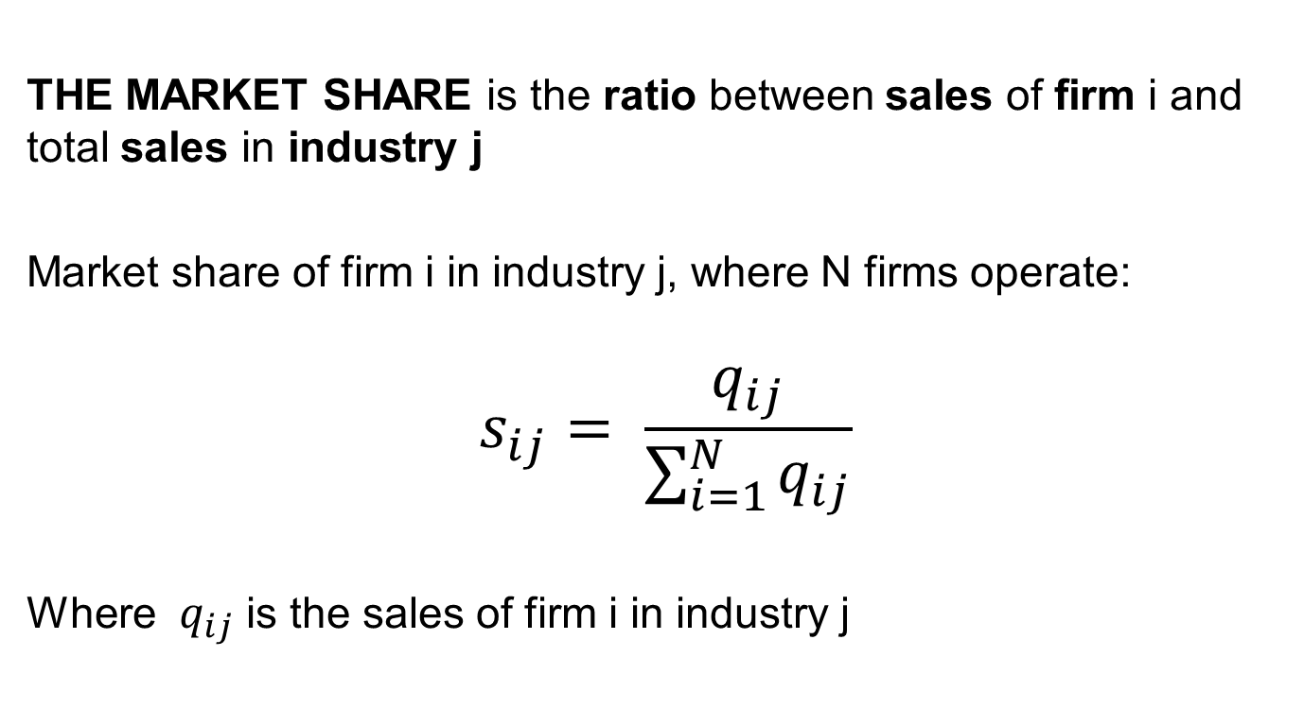
Concentration – The operationalization
THE MARKET SHARE is the ratio between sales of firm i and total sales in industry j
Market share of firm i in industry j, where N firms operate:
$$s_{ij}= \frac{q_{ij}}{\sum_{i=1}^{N}{q_{ij}}}$$
Where $q_{ij}$ is the sales of firm i in industry j
Market share
Industry concentration
Size of the firm

Slide 8
Market shares
N firms per M industries
= sales of firm i in industry j
Firm/Industry | … | … | j | …. | M
…
… |  |  | …
i | … | … |  | …
… |  |  | …
N
Sales of firm ‘i’ in industry ‘j’

Slide 9
Market shares
Focusing on one industry, the market share would be:
s_{i} = q_{i}/Q with Q=Σ_{i}q_{i}
Firm | Sales | Market share
1
2
… | … | …
i
… | …
N

Slide 10
Market shares and the concentration vector
The concentration vector
The concentration vector
lists market shares in descending
order, in order to emphasize
the presence of large firms in
a given industry
Firm | Output | Market share
1 | 500 | 0.5
2 | 300 | 0.3
3 | 100 | 0.1
4 | 70 | 0.07
5 | 25 | 0.025
6 | 5 | 0.005
 | 1000 | 1

Slide 11
Concentration curve
A useful representation of concentration in the Cartesian plane (for a certain industry at time t) is given by the concentration curve
Horizontal axis: firms ordered in decreasing order by size (from the largest to the smallest)
Vertical axis: Cumulative Market Shares (CMS)
CMS
1
0,5
N

Slide 12
Concentration indices
Absolute
Relative
Concentration indices
synthesize in one index the entire information contained in the concentration vector
facilitate the comparison between the degree of concentration in different periods and industries
They can be:
I. Absolute: weighted sum of market shares. With different weights, different concentration indices are identified
II. Relative: capture the degree of inequality between firm sizes within a certain industry

Slide 13
Concentration indices Absolute Concentration ratio
Sum of market shares of the first k firms, in decreasing order
The weight =1 for the first k firms
The weight =0 for the remaining N-k firms
As rule of thumb k is usually equal to 3, 4, 8 or 20

Slide 14
Concentration indices Absolute Concentration ratio
Criticalities:
The choice of k is arbitrary
It provides the same result for industries with different concentration
Example:
Industry A:
Industry B:
→ C_{4A}=0.4 and C_{4B}=0.4
While in A market shares are evenly spread, in B there is one firm that controls almost 40% of the market: this crucial information is lost.

Slide 15
Concentration indices
Absolute
Herfindahl index
The weight of each share is given by the share itself:
the HI is given by the sum of the square of the market shares
The larger a firm, the more it contributes to the value of the index

Slide 16

Concentration indices
Absolute
Herfindahl index
HI ranges from 0 to 1
If there are N firms with the same size,
- In perfect competition HI=0 ( )
- In monopoly HI=1 (N = 1)
$$N→∞$$

Slide 17
Example
US market of credit card suppliers – market shares in 2007 and 2008
Impresa | MS 2007 | MS 2008 | 2007 | 2008
JPMorgan Chase | 17.74% | 21.22% | C₄
Bank of America | 19.36% | 19.25% | 61.53% | 63.01%
Citi | 13.03% | 12.35%
American Express | 11.40% | 10.19% | C₈
Capital One | 6.95% | 6.95% | 80.85% | 83.39%
Discover | 5.65% | 5.75%
Wells Fargo | 3.07% | 4.21% | HI
HSBC | 3.65% | 3.47% | 11.00% | 11.97%
U.S. Bank | 1.84% | 2.14%
USA Savings | 2.01% | 2.02%

Slide 18
Concentration indices
Absolute
Entropy index
In the Entropy index, the weight of each share is equal to the logarithm of the inverse of the market share
Smaller firms provide a greater contribution to the total amount of the index through the inverse of the logarithm

Slide 19
Concentration indices
Absolute
Entropy index
The entropy index provides a measure of disorder, ranging from 0 to infinity
In an industry where there is only one firm, the entropy is minimal:
In an industry with identical firms, the entropy increases together with the increase in N, theoretically approaching infinity in perfect competition

Slide 20
The role of the degree of disaggregation
Concentration indices are used to compare concentration:
Between different industries at the same time
In the same industry over time
The degree of disaggregation needs to be the same in order to meaningfully compare results.
Indeed, the degree of disaggregation of the industry has an impact on concentration (typically, increasing the degree of disaggregation, concentration increases as well)
e.g. Biscuit industry → confectionery ind. → food ind.

Slide 21
The role of the degree of disaggregation
The degree of disaggregation is defined relying on the classification of production activities
There are several national and international classification of production activities that allow for a shared definition of the industries
Example:
ATECO - ATtività ECOnomiche (ISTAT, Italy)
NACE - Nomenclature statistique des activités économiques dans la Communauté européenne (Europe)
SIC, Standard Industrial Classification (US)

Slide 22
Concentration indices
Relative
Relative concentration indices measure the degree of size inequality among firms
Graphically → Lorenz Curve
Numerically → Gini Index
These measures are traditionally adopted in labor economics in order to measure income inequality and income distribution.

Slide 23
Concentration indices
Relative
Lorenz curve
Firms are put in increasing order
On the horizontal axis: cumulated share of the number of firms
e.g. The 10% smallest firms…
On the vertical axis: cumulated market shares
e.g. …produce 20% of the industry output

Slide 24
Concentration indices
Relative
Lorenz curve
The upper bound of the Lorenz curve is given by the perfect equality line
The perfect equality line is the shape the Lorenz curve would get assuming perfect equality:
The first 10% of the firms produce 10% of the output
The second 20% of the firms produce 20% of the output
…

Slide 25
Concentration indices
Relative
Lorenz curve
Note: the portion of plane comprised between the Lorenz curve and the perfect equality line is called concentration area
Perfect equality line
CMS
100%
Concentration area
Lorenz curve
100%
Firms

Slide 26
Concentration indices
Relative
Gini index
Gini index = ratio between the concentration area and the area underlying the perfect equality line
The Gini index varies between 0 and 1:
If all the firms have the same size
The absolute equality line and the Lorenz curve coincide
The concentration area is null
The Gini index is equal to 0
If one firm produces for the entire industry
The concentration area coincides with area underlying the perfect equality line
The Gini index is equal to 1

Slide 27
Encava and Jacquemin qualitative classification
It synthesizes industry concentration in a finite number of categories:
Monopoly: there is one firm with a market share higher than 80%
Dominating firm: there is one firm with a market share between 50% and 80%, and the others are much smaller
Duopoly: 2 firms of similar size control at least 80% of the market
Asymmetric oligopoly: 3 or 4 firms control at least 80% of the market, the highest share being at least 40%
Symmetric oligopoly: 3 or 4 firms equally control at least 80% of the market, all individual shares being lower than 40%
Asymmetric competition: the largest firm holds a market share between 20% and 50%
Symmetric competition: the largest firm controls at most 20% of the market

Slide 28

Questions?

Slide 29
References
Cabral “Introduction to Industrial Organization”, 2000, I edition, ch. 9.1 and 9.2 [or 2018, II edition, ch. 10 - selected parts]

